Slide 1
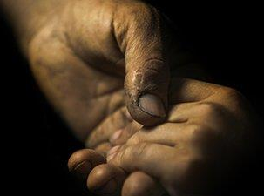
“Why Bother Jesus?”
Mark 5:21-43

Slide 2
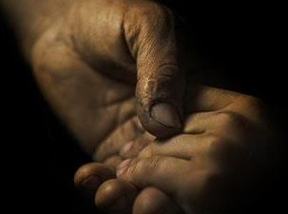
In Mark 5:21-43,
we find people waiting for Jesus:
a heartbroken man, a dying girl,
& an outcast woman

Slide 3
“Don’t be afraid;
just keep on believing.”
Mark 5:36

Slide 4
“Why bother Jesus?”
from Mark 5:35

Slide 6
Why bother Jesus?
because of who he is:
His identity

Slide 7
Why bother Jesus?
because of what he has & does:
His power & authority

Slide 8
Why bother Jesus?
because of how he responds:
His wisdom & empathy

Slide 9
“Don’t be afraid; keep on believing”
Bothering Jesus means
we are continually learning to trust him,
his timing, & purpose in the midst of life.

